Slide 1
NORMALIZATION OF DATABASE TABLES
Database Concepts
Spring 2021
Week 11

Slide 2
Normalization
Evaluating and correcting table structures to minimize data redundancies
Reduces data anomalies
Assigning attributes to tables based on the concept of determination
Normal forms
First normal form (1NF)
Second normal form (2NF)
Third normal form (3NF)
Notes:
Normalization is a process for evaluating and correcting table structures to minimize data redundancies, thereby reducing the likelihood of data anomalies.
Normalization works through a series of stages called normal forms. The first three stages are described as first normal form (1NF), second normal form (2NF), and third normal form (3NF).

Slide 3
Normalization
Structural point of view of normal forms
Higher normal forms are better than lower normal forms
Properly designed 3NF structures meet the requirement of fourth normal form (4NF)
In business database design, 3NF is as high as you need to go in the normalization process
Denormalization: Produces a lower normal form
Results in increased performance and greater data redundancy
Notes:
From a structural point of view, 2NF is better than 1NF, and 3NF is better than 2NF. For most purposes in business database design, 3NF is as high as you need to go in the normalization process.

Slide 4
Functional Dependence Concepts
Concept | Definition
Functional dependence | If each value of A determines one and only one value of B, The attribute B is functionally dependent on the attribute A.
Fully functional dependence (composite key) | If attribute B is functionally dependent on a composite key A but not on any Subset of that composite key, the attribute B is fully functionally dependent on A.
Example: PROJ_NUM --> PROJ_NAME
(read as PROJ_NUM functionally determines PROJ_NAME)
In this case, the attribute PROJ_NUM is known as the determinant attribute, and the attribute PROJ_NAME is known as the dependent attribute
Notes:
Example: PROJ_NUM --> PROJ_NAME
(read as PROJ_NUM functionally determines PROJ_NAME)
In this case, the attribute PROJ_NUM is known as the determinant attribute, and the attribute PROJ_NAME is known as the dependent attribute.
An X(composite key) --> Y is a full functional dependency if removal of any attribute A_{i} from X means that the dependency does not hold any more.

Slide 5
Types of Functional Dependencies
Partial dependency: A dependency based on only a part of a composite primary key
Exist when there is a functional dependence in which the determinant is only part of the primary key
If (A, B) → (C, D) also B → C, and (A, B) is the primary key, then the functional dependence B → C is a partial dependency
Transitive dependency: A dependency of one nonprime attribute on another nonprime attribute
Exist when a functional dependence exists among nonprime attributes
X (primary key) → Y (nonprime), Y → Z (nonprime), the dependency Y → Z is a transitive dependency
Notes:
B → C is a partial dependency because only part of the primary key (B) is needed to determine the value of C.

Slide 6
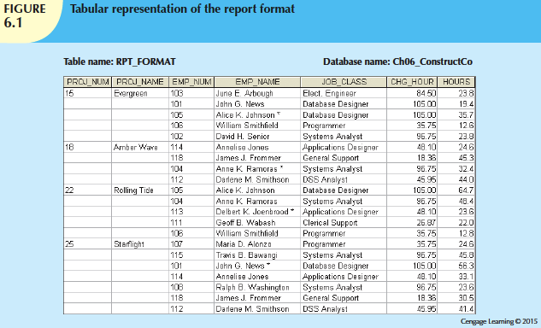
Figure 6.1

Slide 7
Conversion to First Normal Form (1NF)
Steps
Eliminate the repeating groups
Identify the primary key
Identify all dependencies
Repeating group: Group of multiple entries of same type Existence proves the presence of data redundancies

Slide 8
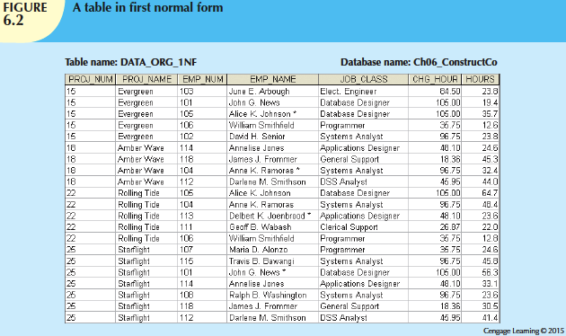
Figure 6.2
Notes:
To eliminate the repeating groups, eliminate the nulls by making sure that each repeating group attribute contains an appropriate data value.

Slide 9
Dependency diagram
Dependency diagram: Depicts all dependencies found within given table structure
Helps to get an overview of all relationships among table’s attributes
Makes it less likely that an important dependency will be overlooked

Slide 10
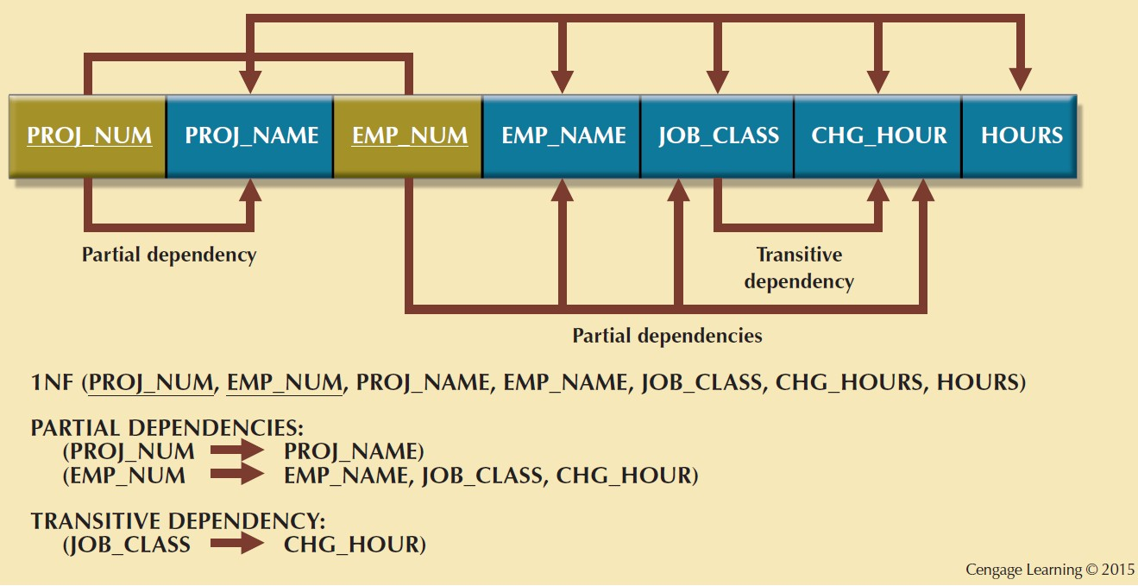
Figure 6.3 - First Normal Form (1NF) Dependency Diagram
Notes:
The problem with the 1NF table structure shown in Figure 6.3 is that it contains partial dependencies—that is, dependencies based on only a part of the primary key.

Slide 11
Conversion to Second Normal Form
Steps
Make new tables to eliminate partial dependencies
Reassign corresponding dependent attributes
Table is in 2NF when it:
Is in 1NF
and
Includes no partial dependencies (that is, if the 1NF has a single- attribute primary key, then the table is automatically in 2NF)
Notes:
Conversion to 2NF occurs only when the 1NF has a composite primary key. If the 1NF has a single-attribute primary key, then the table is automatically in 2NF.

Slide 12
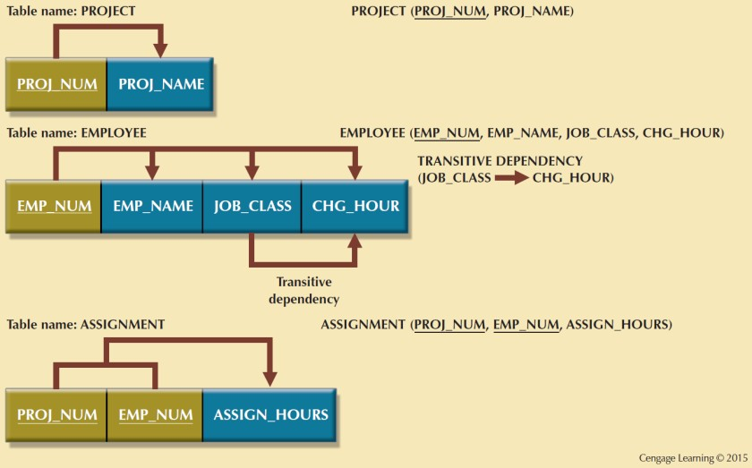
Figure 6.4 - Second Normal Form (2NF) Conversion Results

Slide 13
Conversion to Third Normal Form
Steps
Make new tables to eliminate transitive dependencies
Reassign corresponding dependent attributes
Table is in 3NF when it:
Is in 2NF
and
Contains no transitive dependencies

Slide 14
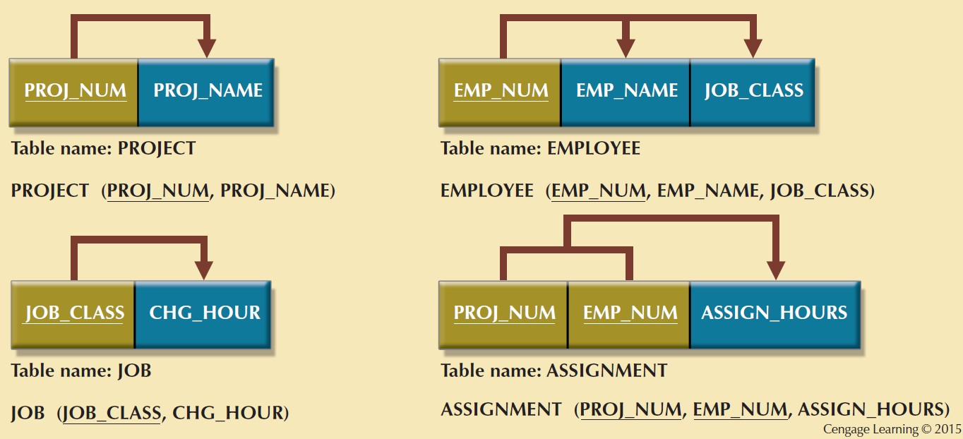
Figure 6.5 - Third Normal Form (3NF) Conversion Results

Slide 15
Example

Slide 16
The Boyce-Codd Normal Form (BCNF)
A table is in BCNF when every determinant in the table should be a candidate key
Candidate key - Same characteristics as primary key but not chosen to be the primary key
Equivalent to 3NF when the table contains only one candidate key
Violated only when the table contains more than one candidate key
Considered to be a special case of 3NF
→ When a nonkey attribute determines part of the primary key, it may meet the 3NF requirements although it fail to meet the BCNF requirements.
Notes:
BCNF always satisfy 3NF.
when a table contains only one candidate key, the 3NF and the BCNF are equivalent.
In other words, BCNF can be violated only when the table contains more than one candidate key.

Slide 17
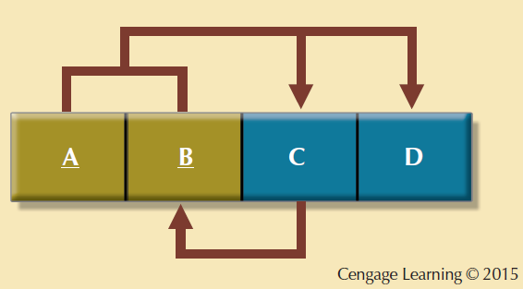
Figure 6.7 - A Table That is in 3NF and not in BCNF
Notes:
this structure has two candidate keys: (A + B) and (A + C). The table structure shown in Figure 6.7 has no partial dependencies, nor does it contain transitive dependencies. (The condition C-B indicates that a non-key attribute determines part of the primary key—and that dependency is not transitive or partial because the dependent is a prime attribute!!!) Thus, the table structure in Figure 6.7 meets the 3NF requirements, but the condition C--B causes the table to fail to meet the BCNF requirements.
A violation of BCNF is typical on a table has two candidate keys that share a common attribute.

Slide 18
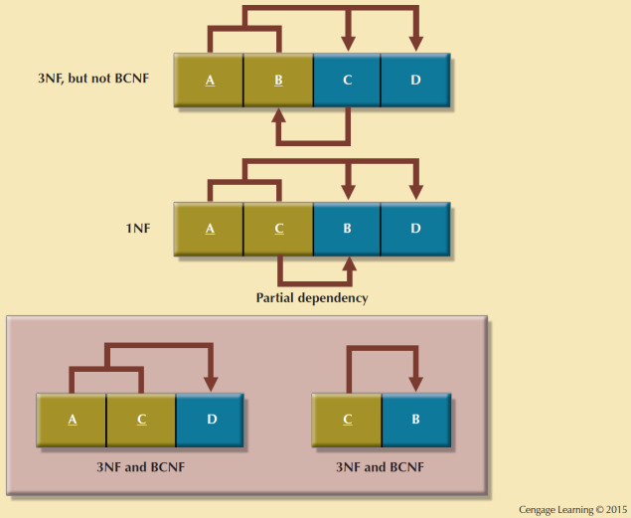
Figure 6.8 - Decomposition to BCNF
Notes:
First change the primary key to A + C. This change is appropriate because the dependency C--B means that C is effectively a superset of B.

Slide 19
***Fourth Normal Form (4NF)
Table is in 4NF when it:
Is in BCNF and
Includes no multivalued dependencies (A multivalued dependency always requires at least three attributes because it consists of at least two attributes that are dependent on a third)
Multivalued dependency occurs when there are more than one independent multivalued attributes in a table.
This table has introduced a multivalued dependency because the major and the sport are independent of one another but both depend on the student.
Notes:
The problem here is that both Ravi and Beth play multiple sports. It is necessary to add a new row for every additional sport.
If a three-way relationship represented by a table that should actually be represented by two binary relationships, the table violates 4NF.

Slide 20
Normalization and Database Design
Normalization should be part of the design process
Proposed entities must meet the required normal form before table structures are created
Principles and normalization procedures to be understood to redesign and modify databases
ERD is created through an iterative process
Normalization focuses on the characteristics of specific entities

